Slide 1

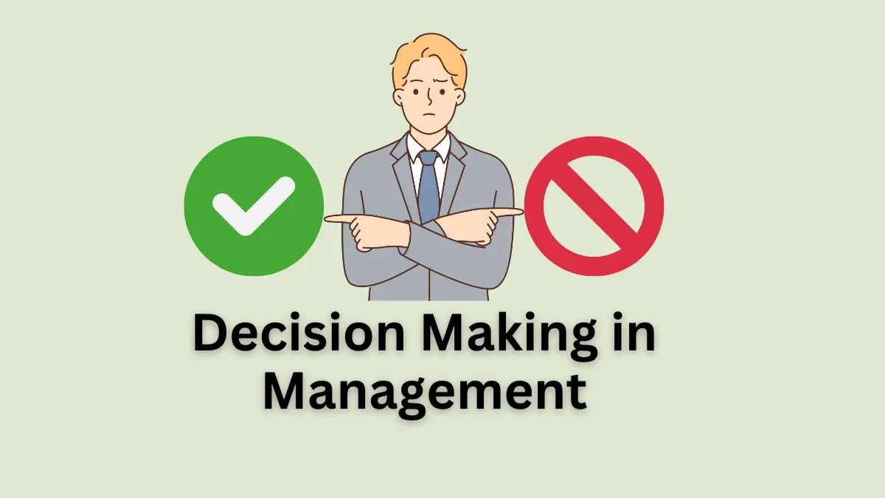





Slide 2





Describe the decision-making process
Explain the four ways managers make decisions.
Classify decisions and decision-making conditions
Describe different decision-making styles and
discuss how biases affect decision making.
Identify effective decision-making techniques.
01
Jens Martensson

Slide 3
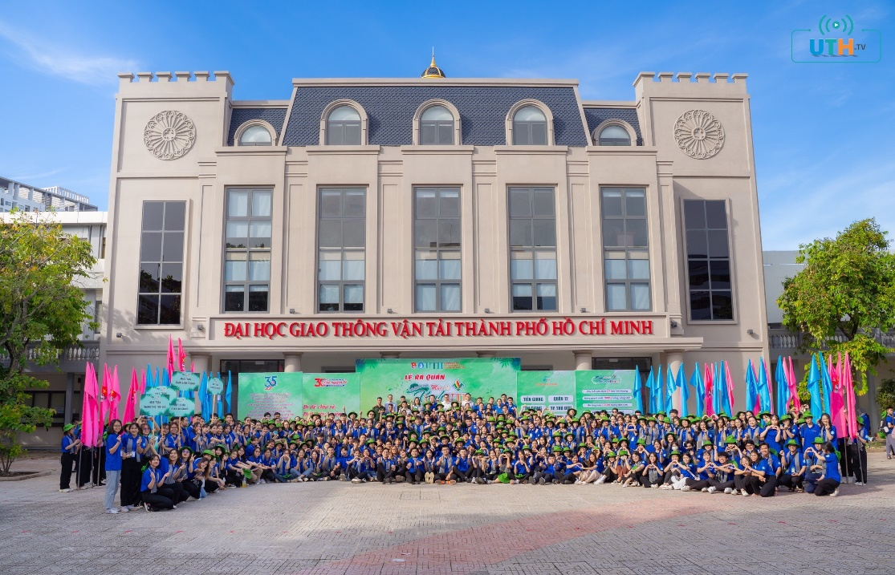


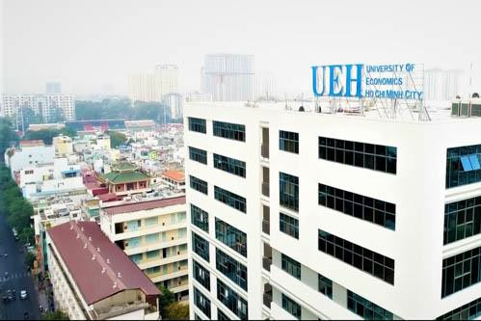
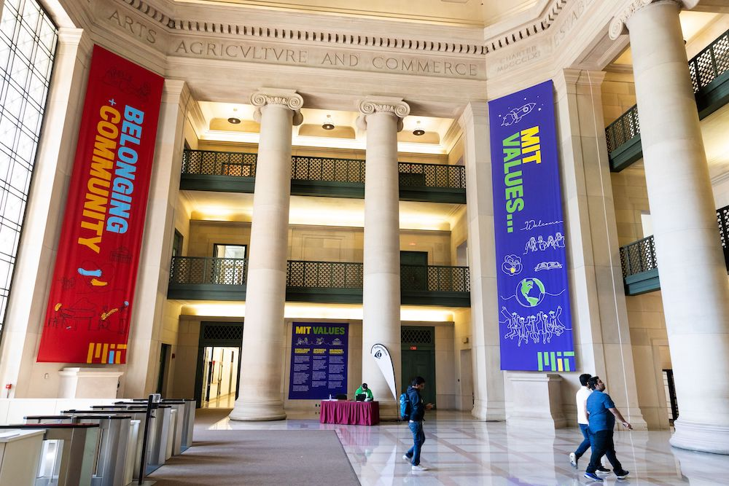


02
Jens Martensson3

Slide 4

DECISION
Decision – a choice from two or more alternatives.
02
Jens Martensson3

Slide 5
THE NATURE OF MANAGERIAL DECISION MAKING
Decision making - The process by which managers respond to opportunities and threats by analyzing options and making decisions about goals and courses of action.
+ Decisions in response to opportunities - occurs when managers respond to ways to improve organizational performance.
+ Decisions in response to threats - occurs when managers are
impacted by adverse events to the organization.
03
Jens Martensson5

Slide 6


THE NATURE OF MANAGERIAL DECISION MAKING
“Whatever a manager does, he does through making decisions.”
P. F. Drucker
03
Jens Martensson5

Slide 7
THE NATURE OF MANAGERIAL DECISION MAKING
PLANNING
ORGANIZING
LEADING
CONTROLLING
03
Jens Martensson5

Slide 8

THE NATURE OF MANAGERIAL DECISION MAKING
Finding…
…right
answer
…right
question
04
Jens Martensson8

Slide 9
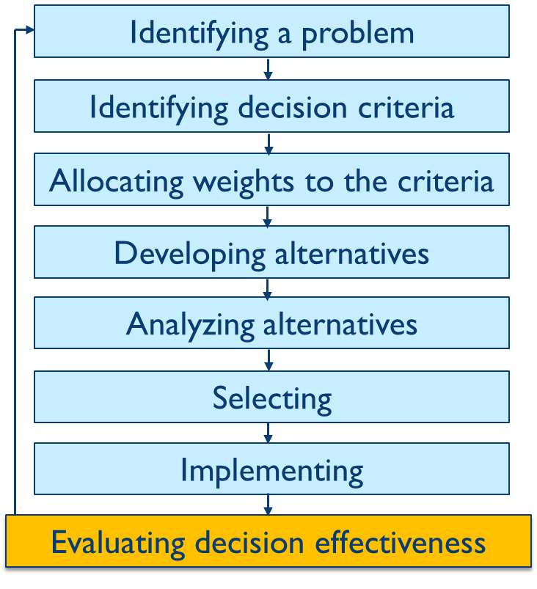
DECISION-MAKING PROCESS
05
Jens Martensson9

Slide 10

STEP 1: IDENTIFY A PROBLEM
Problem is an obstacle that makes it difficult to achieve a desired goal or purpose.
Symptom of problem
Problem
VS
06
Jens Martensson10

Slide 11

STEP 1: IDENTIFY A PROBLEM
Problem
Need a new laptop
07
Jens Martensson11

Slide 12

STEP 2: IDENTIFYING DECISION CRITERIA
Memory
Display quality
Battery life
Warranty
Weight
…
Decision criteria - criteria that define what’s important or relevant to resolving a problem
08
Jens Martensson12

Slide 13
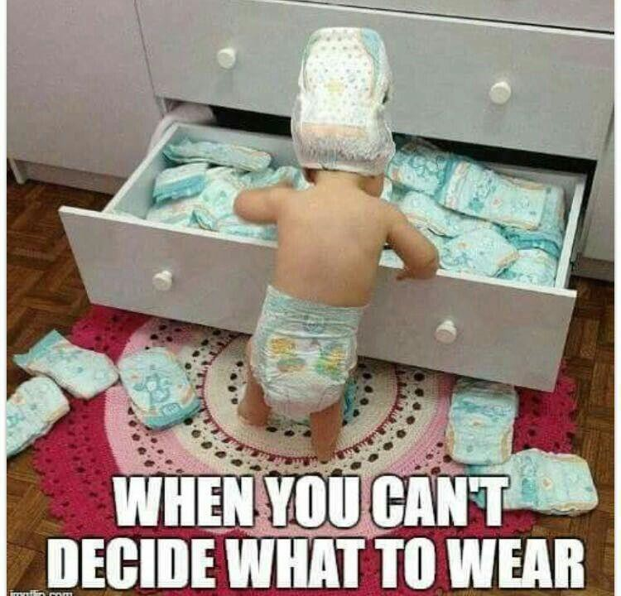
09
Jens Martensson13

Slide 14
STEP 3: ALLOCATE WEIGHTS TO THE CRITERIA
The decision maker must weight the items in order to give them the correct priority in the decision.
Criteria | Weight
(1) Memory
(2) Display quality
(3) Battery life
(4) Warranty
(5) Carrying weight
Jens Martensson14

Slide 15




STEP 4: DEVELOP ALTERNATIVES
List viable alternatives that could resolve the problem.
Jens Martensson14

Slide 16
STEP 5: ANALYZE ALTERNATIVES
Appraising each alternative’s strengths and weaknesses.
Assessing the value of each alternative by making a value judgment of the feature.
An alternative’s appraisal is based on its ability to resolve the issues related to the
criteria and criteria weight.
 | (1) | (2) | (3) | (4) | (5)
HP | 10 | 3 | 10 | 8 | 5
Sony | 8 | 7 | 7 | 7 | 8
Lenovo | 5 | 5 | 7 | 9 | 10
Dell | 10 | 7 | 8 | 6 | 7
ASUS | 7 | 8 | 8 | 7 | 7
Jens Martensson14

Slide 17
STEP 6: SELECT AN ALTERNATIVE
Choosing the best alternative
The alternative with the highest total weight is chosen.
 | (1) | (2) | (3) | (4) | (5) | Total
HP | … | … | … | … | … | 231
Sony | … | … | … | … | … | 230
Lenovo | … | … | … | … | … | 198
Dell | … | … | … | … | … | 249
Toshiba | … | … | … | … | … | 231
Jens Martensson14

Slide 18
DECISION-MAKING PROCESS
Need new laptop
Memory/ Display quality/ Battery life/ Warranty/ Weight
Memory (8)/ Display quality (6)/ Battery life (7)/…
HP/ Sony/ Lenovo/ Dell/ ASUS
Putting the chosen alternative into action
How effectively was the problem resolved ?
Jens Martensson14

Slide 19

EXERCISE
CHOOSING NEW SUPPLIER
15
19Jens Martensson

Slide 20
RATIONAL DECISION-MAKING
Describes choices that are logical and consistent and maximize value
The problem: clear and unambiguous
The goal: clear and specific
All alternatives and consequences are known
Preferences are constant and stable
No time or cost constraints exist
16
Jens Martensson20

Slide 21


STRUCTURED – UNSTRUCTURED PROBLEMS
Structured problems
Straightforward
Familiar
Easily defined
Unstructured problems
New or unusual
Ambiguous
Incomplete information
Jens Martensson21

Slide 22
PROGRAMMED - NONPROGRAMMED DECISIONS
Programmed decisions - a repetitive decision that can be handled by a routine approach
Non-programmed decisions - Unique and nonrecurring decisions that require a custom-made solution
Jens Martensson21

Slide 23
PROGRAMMED - NONPROGRAMMED DECISIONS
Programmed decisions are based on:
  Procedure: A series of sequential steps used to respond to a well-structured problem
  Rule: An explicit statement that tells managers what can or cannot be done
  Policy: A guideline for making decisions
Jens Martensson21

Slide 24
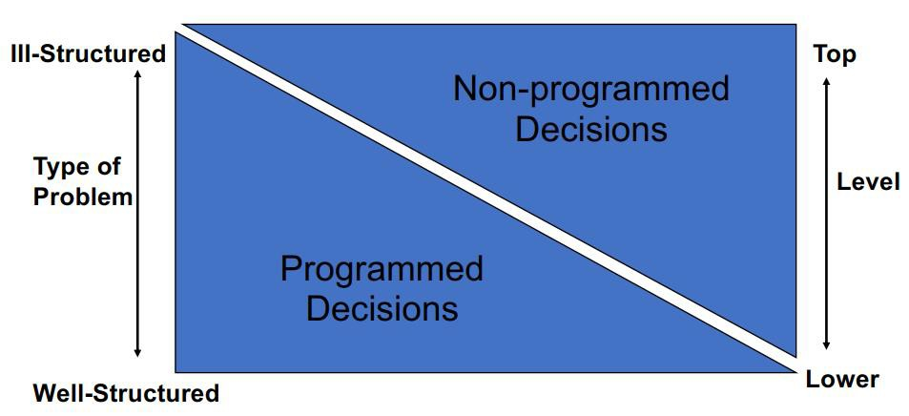
RELATIONSHIP OF PROBLEMS, DECISIONS, AND LEVEL
Jens Martensson21

Slide 25
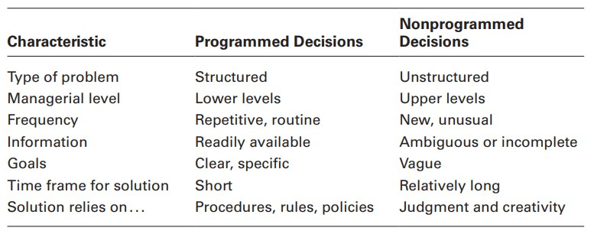
PROGRAMMED VERSUS NONPROGRAMMED DECISIONS
…
…
…
…
…
…
…
Jens Martensson21

Slide 26
DECISION-MAKING CONDITIONS
Certainty – a situation in which a manager can make accurate decisions because all outcomes are known.
Risk – a situation in which the decision maker is able to estimate the likelihood of certain outcomes.
Uncertainty – a situation in which a decision maker has neither certainty nor reasonable probability estimates available.
23
Jens Martensson26

Slide 27




INDIVIDUAL/ GROUP DECISION-MAKING
Individual decision- making
Group decision- making
Discussion: Pros and cons
23
Jens Martensson26

Slide 28
INDIVIDUAL DECISION MAKING - PROS AND CONS
ADVANTAGES DISADVANTAGES
Time and cost saving
High level of responsibility
Avoid conflict
Less dominated by various people
Limit of information and knowledge
May not consider many aspects of the
problem
Less alternatives
No democracy
The solution is usually not widely accepted
Jens Martensson28

Slide 29

GROUP DECISION-MAKING
ADVANTAGES
DISADVANTAGES
Time-consuming
Domination by a few
Pressure to conform
More complete information
Diversity of experience
Generation of more alternatives
Solutions more likely to be accepted by those concerned
Jens Martensson28

Slide 30

TECHNIQUES OF GROUP DECISION-MAKING
Brainstorming
Nominal Group Technique
Delphi Technique
Jens Martensson28

Slide 31
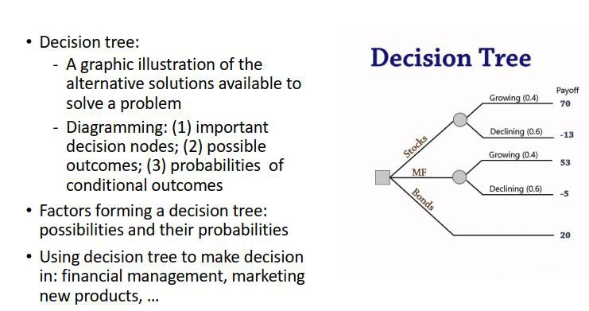
DECISION TREE
31
Jens Martensson31

Slide 32
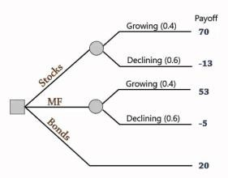
DECISION TREE
Decision node
States of nature node
31
Jens Martensson31

Slide 33
DECISION TREE
Draw a decision tree for the following information:
Option (i) | Possibility (j)
 | High demand (j=1) | Low demand (j=2)
Large factory (i=1) | 200.000 | -180.000
Small factory (i=2) | 100.000 | -20.000
Probability | 0,5 | 0,5
31
Jens Martensson31

Slide 34
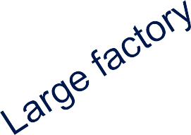
DECISION TREE
10.000
High (0.5)
200.000
Low (0.5)
-180.000
40.000
High (0.5)
100.000
Small factory
Low (0.5)
-20.000
0
0
32
Jens Martensson34

Slide 35


THANK YOU!!!

